Slide 1

IMDb Movie Analysis
Exploratory SQL analysis of movies released 2010–2019
~ By Shaun Raymond M. Okwuosa

Slide 2
Initial Exploration
Steady growth, then a drop-off
Annual releases climbed from 11.8K (2010) to 16.8K (2018); 2019 shows only 8.4K — the sample looks incomplete, not a real decline.
145,081
Documentary and Drama lead
movies released
2010–2019
Documentary (32,106) and Drama (21,306) are the top single genres — well ahead of Comedy (9,096), the next closest.
Only 51% of movies
(73,856) carry a rating
avg. rating 6.33 / 10
Ratings cluster in the middle
Most rated movies fall in the 5–6.9 and 7–8.9 brackets (over 80% of rated titles); very few sit at the extremes.

Slide 3
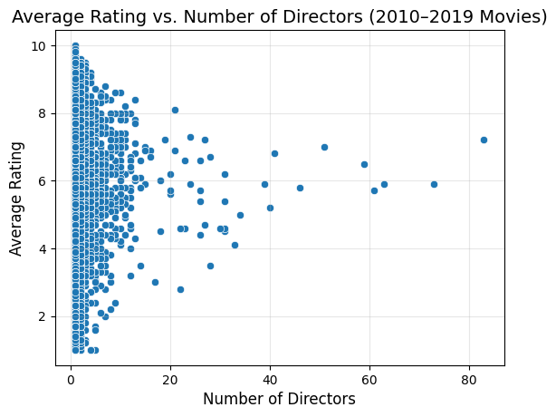
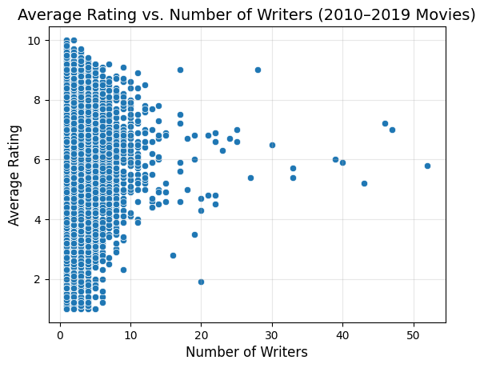
Business Question
Do larger creative teams produce higher-rated movies?
No relationship found — average rating is spread evenly across every team size. For this dataset, the number of directors or writers does not predict how a movie is rated.

Slide 4
Data Cleaning Tasks
Identified during exploration — needed before deeper analysis
Missing runtime
Pipe-separated genres
30,765 movies have a null runtime_minutes — exclude from runtime-based analysis.
Genres are stored as 'Comedy|Drama|Romance' — split into rows for detailed genre analysis.
Missing / empty genres
Inconsistent casing
5,359 movies have no genre listed — exclude when grouping or filtering by genre.
region / language fields vary in capitalization — standardize before grouping.
Unrated movies
Incomplete 2019 data
Only 51% of movies have a rating — INNER JOIN to movie_ratings excludes the rest automatically.
2019 has ~8.4K movies vs. ~17K in prior years — exclude from year-over-year trends.
Duplicate credits
A director/writer can appear more than once per movie — use COUNT(DISTINCT person_id).

